Slide 1
Accident Analysis
Shahd Ahmed Bakoush

Slide 2
Project Introduction
2
Road traffic accidents are one of the most significant challenges facing our communities today, impacting lives and economies on a large scale.
In our ongoing efforts to enhance road safety and reduce the number of accidents, we have conducted an in-depth analysis of available accident data. This project aims to uncover the root causes of these incidents and identify the most high-risk areas.
Using advanced data analysis tools like Tableau, we have developed an interactive dashboard that provides clear and actionable insights.
This presentation will walk you through the key findings of our analysis and present practical recommendations to improve road safety and reduce accident.

Slide 3
Data Cleaning Steps
3
What We Did to Clean the Data:
1. Removed Duplicates:
- Ensured there were no duplicate entries.
- Deleted duplicate rows to ensure accurate analysis.
2. Handled Missing Values:
- Removed rows with missing or incomplete data.
- Ensured the dataset was complete.
3. Formatted the Data:
- Standardized column formats (e.g., dates, numbers).
- Adjusted formatting for consistency and readability.
The Result:
- Clean, ready-to-analyze data.
- Accurate and reliable analysis.

Slide 4
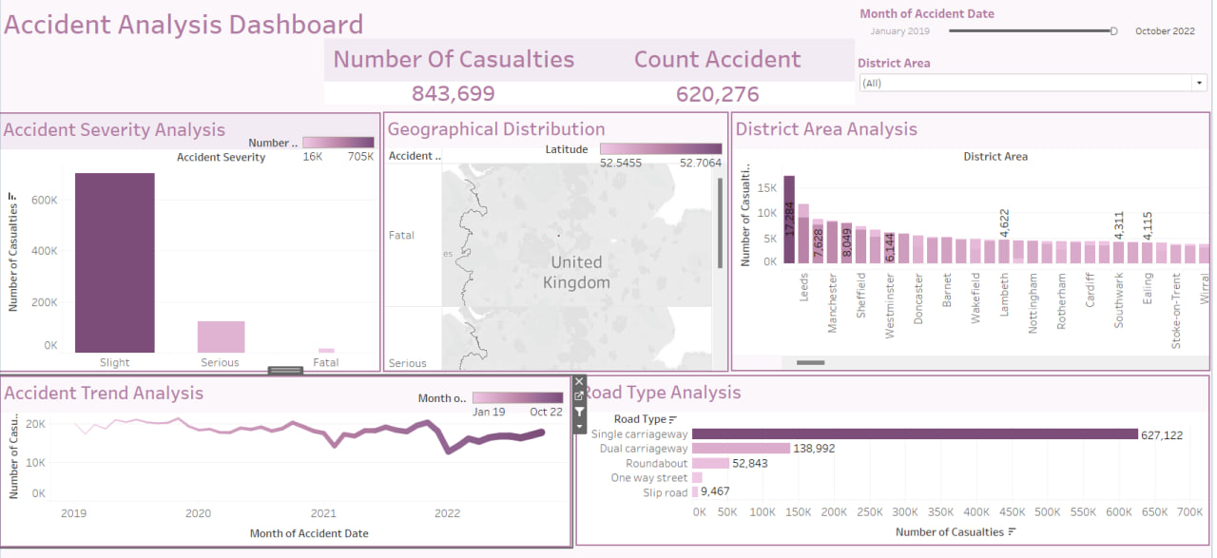
Accident Analysis Dashboard Overview
- A tool to analyze accident data, focusing on:
- Casualties: Total of 843,699.
- Geographical Distribution: Key locations at 52.5453 and 52.7044.
- Severity: Breaks down accidents by severity (minor, serious, fatal).
- Trends: Shows how accidents have changed over time.
- Helps identify high-risk areas and trends to improve road safety.

Slide 5
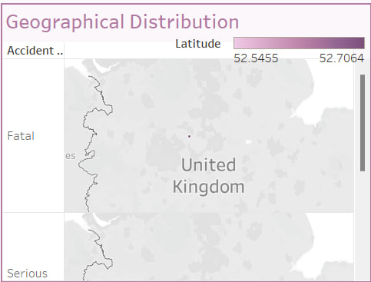

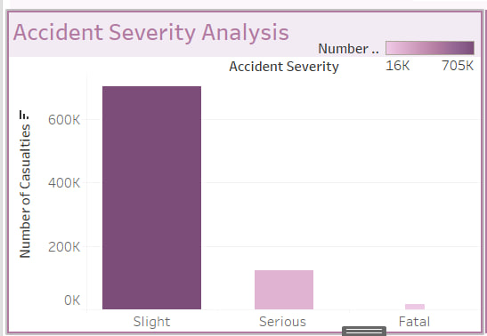

Geographical Distribution :
---What does it show ?
- Geographical areas of accidents:
- Latitude: 52.5455 and 52.7064.
- Country: United Kingdom.
- Accident severity:
- Fatal accidents: Highlighted.
- Serious accidents: Also mentioned.
--- How to use it?
- Visual map: Display high-risk areas.
- Recommendations: Focus on improving safety in areas with fatal accidents.
Accident Severity Analysis :
--- What does it show?
- Distribution of accidents by severity:
- Slight accidents: From 100K to 300K.
- Serious accidents: From 150K to 300K.
- Fatal accidents: Mentioned without details.
--- How to use it?
- Chart: Display the distribution of accidents by severity.
- Recommendations: Focus on reducing serious and fatal accidents.

Slide 6
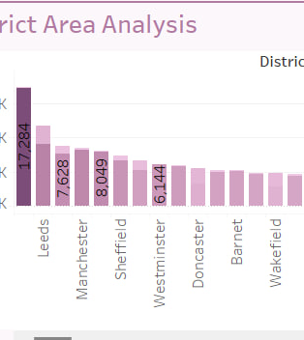
District Area Analysis :
What does it show?
Number of casualties by district:
17,284 casualties in the listed areas.
Key areas: Manchester, Sheffield, Westminster, Doncaster, and others.
How to use it?
Highlight high-risk areas: Focus on districts with the highest number of casualties.
Recommendations: Propose safety improvements in these areas.

Slide 7
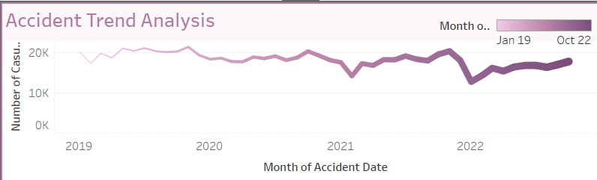
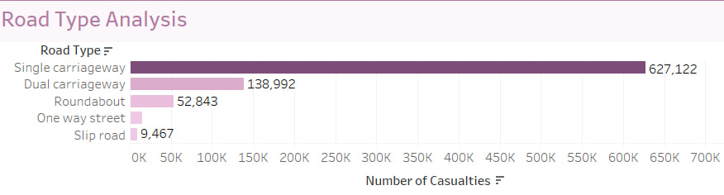
Accident Trend Analysis : What does it show? - Accident trends over time: - 2019 to 2022: Shows changes in the number of accidents. - Specific months: January 2019 and October 2022. How to use it? - Line chart: Display how accident numbers have changed over time. - Recommendations: Identify periods with increased accidents and suggest preventive measures.
Road Type Analysis
What does it show?
- Most dangerous road types: - Single carriageway. - Dual carriageway.
- Roundabouts. - One-way streets. - Slip roads.
Number of casualties: 138,992 and 52,843.
How to use it?
- Chart: Display the distribution of accidents by road type.
- Recommendations: Focus on improving safety for the most dangerous road

Slide 8
Thank You
Linked In

